Slide 1
Expense Reimbursement System
By: Boyd Thurston

Slide 2
Technologies Used
Java 1.8
Maven
Servlet 3.1
JDBC
PostgreSQL
HTML/JS/CSS
JUnit (integration tests)

Slide 3
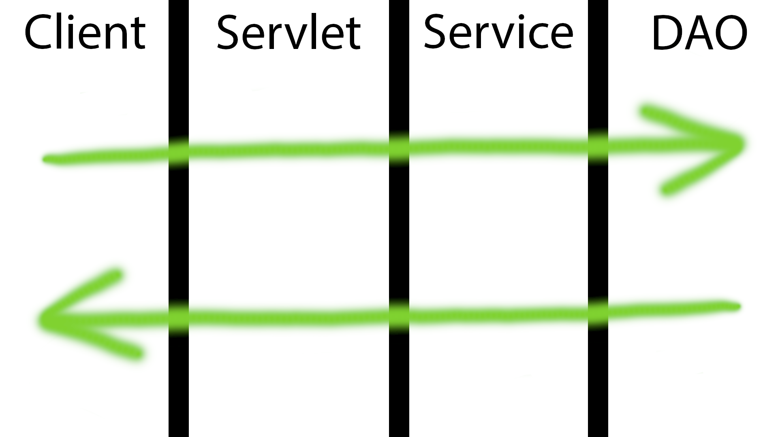
Data Flow

Slide 4
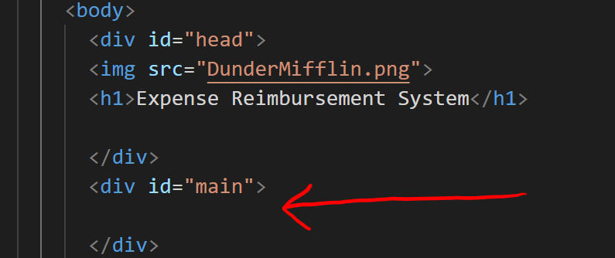
DOM Manipulation
SPA

Slide 5
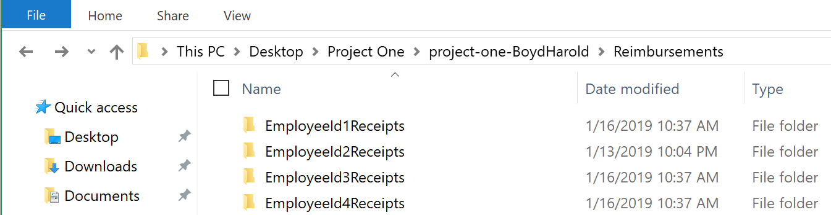
Storing Receipts
Images stored on machine hosting Servlet.
Reference to file location stored within the Database.
Folders are dynamically created for each Employee.

Slide 6
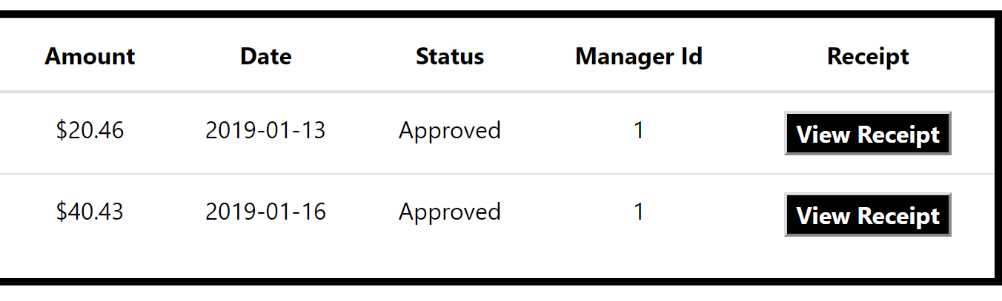
Retrieving Receipts
Uses dynamically created buttons with an onclick event listener passing the location of the receipt image to a function that opens a new tab, triggering a doGet method within a Servlet which returns the specified image.

Slide 7
Demonstration
Launch Demo

